Slide 1

Machine Learning for Subsurface engineers
Dursun Dashdamirov, Nadir Zeynalli, Vugar Dunyamaliyev
Session V, 22 March 2026

Slide 2
Machine Learning for Subsurface engineers
This program is dedicated to applications of Machine Learning on various subsurface disciplines, including geology, geophysics, drilling, petroleum, and reservoir engineering.
Topics
Predictive Modeling with subsurface data
Supervised Learning (Regression)
3. Supervised Learning (Classification)
Unsupervised learning
Neural Networks
6. Generalization, Uncertainty Quantification, Explainability
7. Capstone Project
Format
Online, with hands-on math/programming exercises
6 lectures in 6 weeks + 1 lecture for presentations
15 February - 22 March (Sundays, 6-8 pm Baku time)
Today, we’ll introduce Capstone Project at the end of the class

Slide 3
6. Model Generalization & communication
Nadir Zeynalli, Dursun Dashdamirov
6.1 uncertainty quantification
6.2 model generalization
6.3 explainability

Slide 4


6.1 Uncertainty quantification
Q: Is there sand risk for this well?
Engineer 1:
Yes, definitely
ML model:
Yes
Humans naturally express uncertainty
“probably”, “maybe”, “not sure”
Models give confident point predictions
often overconfident, even when wrong
In real-world decisions, confidence matters as much as prediction
we need to know how much to trust the output
ML model:
No
Engineer 2:
Not sure, but most probably yes
Engineer 3:
Cant say, I need more data

Slide 5
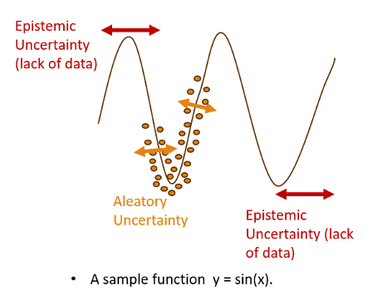
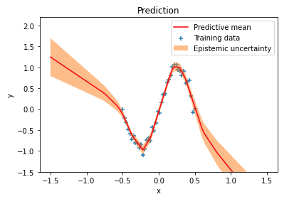
6.1 Types of uncertainty
Aleatoric Uncertainty – Data uncertainty:
Comes from noise in the data
Cannot be reduced, even with more data
Example:
Same KH, different productivity
Epistemic Uncertainty – Model uncertainty:
Comes from lack of knowledge (limited data)
Can be reduced with more data
High in regions where model has not seen data
Intuition:
Aleatoric – Reservoir is inherently variable
Epistemic – We don’t know the reservoir well enough yet

Slide 6
5.1 measuring uncertainty
Measuring uncertainty
Intrinsic methods
Post-hoc methods
Bootstapping
Quantile regression
Bayesian approaches
Calibration
Conformal Prediction
Intrinsic Methods (Built-in Uncertainty):
Uncertainty is learned directly during model training
Model outputs prediction + uncertainty together
Requires modifying or choosing specific algorithms
Post-hoc Methods (After Training):
Applied after the model is trained
Use model predictions to estimate or adjust uncertainty
Do not require changing the original model
https://christophm.github.io/interpretable-ml-book/overview.html
Notes:
Calibration – adjusts predicted probabilities to match reality Conformal Prediction – builds prediction intervals with guaranteed coverage

Slide 7
6.1 bootstrapping (monte carlo uncertainty)
Original dataset
Sample id | Time (days) | Production (STB/day)
1 | 15 | 1020
2 | 16 | 950
3 | 17 | 870
4 | 18 | 780
5 | 19 | 690
Dataset 1
[1, 2, 2, 4, 5]
Dataset 2
[2, 3, 3, 4, 5]
Dataset 3
[1, 1, 2, 3, 5]
Dataset 4
[1, 3, 4, 4, 5]
Prediction 1
720
Prediction 2
690
Prediction 3
760
Prediction 4
710
Bootstrapping
Each bootstrap dataset has the same size as the original dataset, but samples may repeat
Some points appear multiple times
Some points may disappear
720, 690, 760, 710
P90 ≈ 690 P50 ≈ 720 P10 ≈ 760
Conservative → 690 Median → 720 Optimistic → 760
Bootstrapping estimates uncertainty by training many models on resampled datasets.
If predictions change a lot across bootstrap models → uncertainty is high.
If predictions are similar → uncertainty is low.

Slide 8
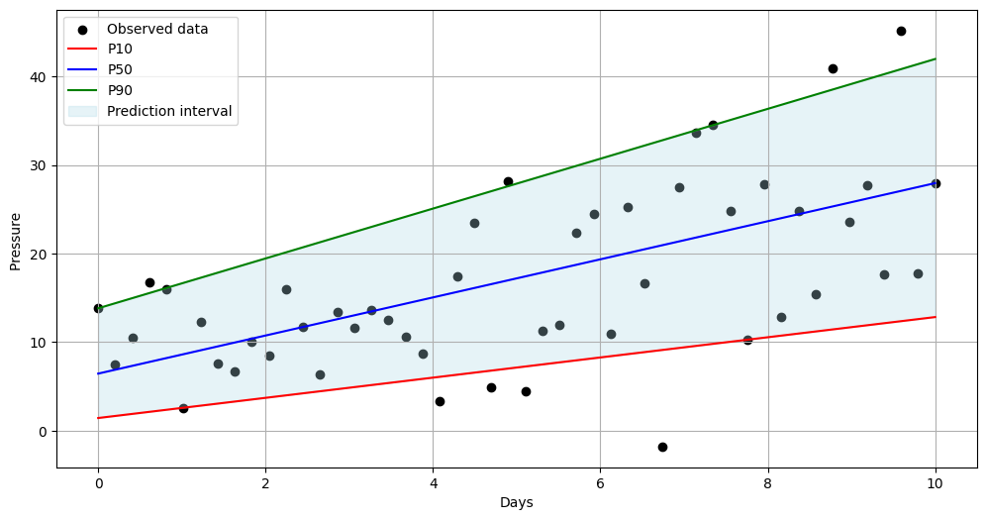
6.1 Quantile regression
Original dataset
Quantile regression
Model learns uncertainty (quantiles) directly
Train for P90, P50, P10 directly
Ordinary regression models treats overprediction and underprediction symmetrically
Quantile regression treats them asymmetrically
Model 1
Train for P10
Model 2
Train for P50
Model 3
Train for P90
Prediction 1
760
Prediction 2
710
Prediction 3
690
P10
P50
P90
P10 model example:
Actual value = 100
Model prediction = 80
Loss = ?
P90 model example:
Actual value = 100
Model prediction = 80
Loss = ?
Ordinary regression model:
Actual value = 100
Model prediction = 80
Loss = 20

Slide 9


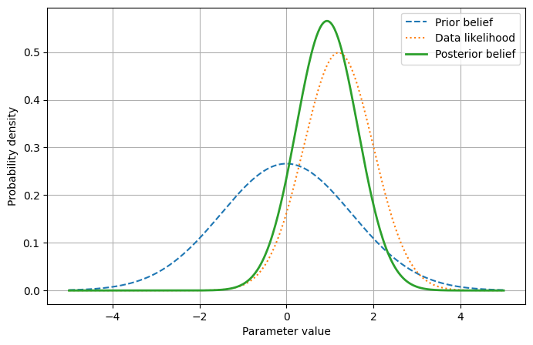
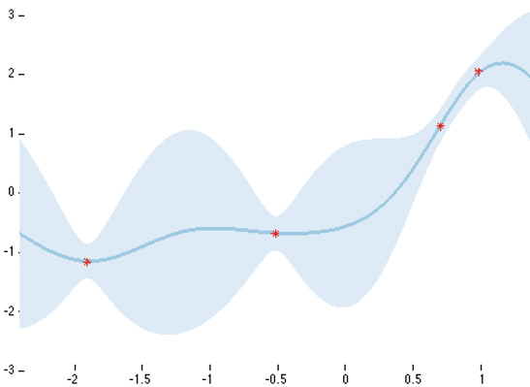




6.1 Bayesian approach
Linear regression
Bayesian vocabulary:
Prior - What we believe before seeing data
Data - Observed training samples
Posterior - Updated belief after seeing data
Bayesian regression
$$h_{θ}\left(x\right)=θ_{0}+θ_{1}x$$
$θ_{0}=5$
$θ_{1}=2$
$$h_{θ}\left(x\right)=θ_{0}+θ_{1}x$$
$$θ_{0}\sim distribution$$
$$θ_{1}\sim distribution$$
slope is probably around 2.0
but not exactly known
there is uncertainty around it
fixed numbers
Overconfident parameters
Prior belief + Data = Posterior belief
Bayesian learning starts with an initial belief, called a prior
Then data updates that belief.
The result is the posterior, which is our new uncertainty-aware estimate.
https://geostatsguy.github.io/MachineLearningDemos_Book/MachineLearning_Bayesian_linear_regression.html

Slide 10
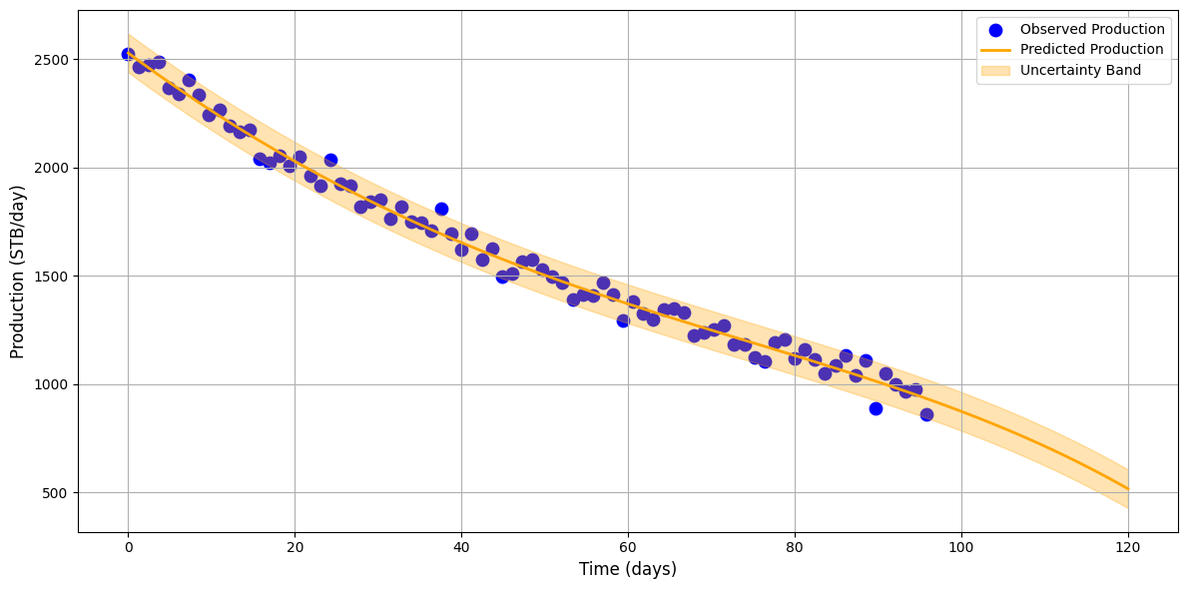
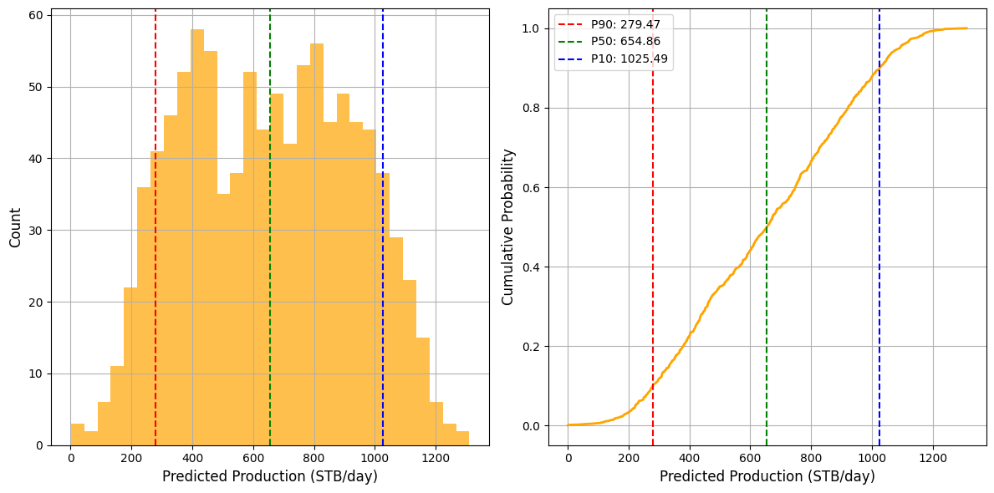
5.1 Uncertainty quantification
Scenario:
Model prediction = 800 stb/d
Actual production = ?
Source of uncertainty:
noisy data
limited training samples
randomness in model training
Imperfect models
np.random.seed(42)
Instead of predicting a single value, we predict a distribution of possible outcomes.
Good ML models estimate both prediction and uncertainty

Slide 11
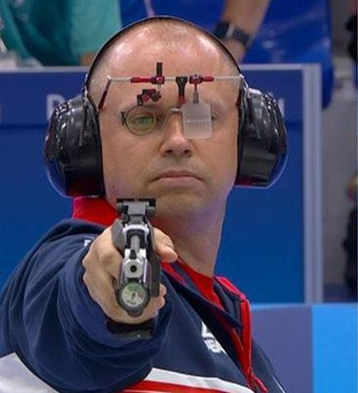

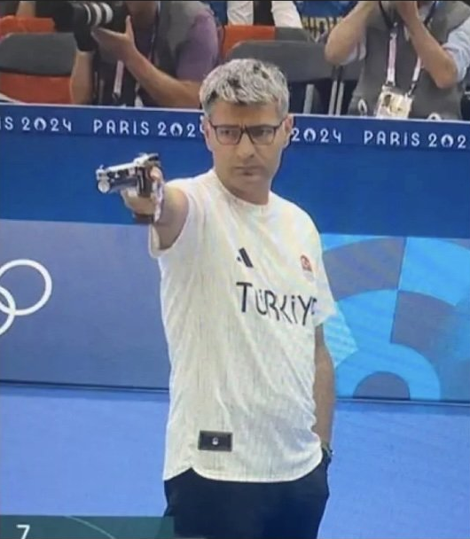

Training for Generalization
Training set
Test set
Player 1
2024 Summer Olympics
Free pistol (50 m)
Perfectly prepared with
Ideal equipment
For 10m air pistol
Who looks more prepared?
Greatly prepared with
little equipment
For 10-25m air pistol
Military training
Player 2
*Theoretical example

Slide 12

1.1 Supervised machine learning
This is a type of machine learning paradigm where an algorithm learns to map input data to a specific output based on example input-output pairs.
$$Y=f\left(x_{1},x_{2},x_{3}\right) + ε$$
Target
Response
Dependent
Irreducible error
Caused by
1. Noise
2. Missing features
Bonus:
Deterministic structure relating 𝑥 to 𝑦
Predictor
Input
Independent
=
f(
)
k (mD) | Net Pay (ft) | Sw
12 | 18 | 55
35 | 25 | 48
120 | 42 | 32
250 | 55 | 28
8 | 15 | 60
Productivity (y)
0
1
2
2
0

Slide 13

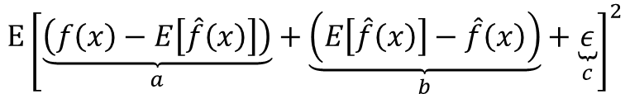
Understanding prediction error
Real target
$$y=f\left(x\right)+ε$$
Expected error
$$Error = E\left[{\left(y−\hat{y}\right)}^{2}\right] = E\left[{\left(f\left(x\right)−\hat{f}\left(x\right)+ε\right)}^{2}\right]$$
Modify
$$E{\left[\underset{a}{\underbrace{\left(f\left(x\right)−E\left[\hat{f}\left(x\right)\right]\right)}}+\underset{b}{\underbrace{\left(E\left[\hat{f}\left(x\right)\right]−\hat{f}\left(x\right)\right)}}+\underset{c}{\underbrace{ε}}\right]}^{2}$$
$$=\underset{{\text{Bias}}^{2}}{\underbrace{{\left(f\left(x\right)−E\left[\hat{f}\left(x\right)\right]\right)}^{2}}}+\underset{\text{Variance}}{\underbrace{E\left[{\left(\hat{f}\left(x\right)−E\left[\hat{f}\left(x\right)\right]\right)}^{2}\right]}}+\underset{\text{Irreducible}}{\underbrace{σ^{2}}}+\underset{\text{cross} \text{terms} \text{vanish}}{\underbrace{2⋅0+2⋅0+2⋅0}}$$
Model limitations
Data noise
*Expectation operator lets us compute the average behavior over all possible datasets.

Slide 14
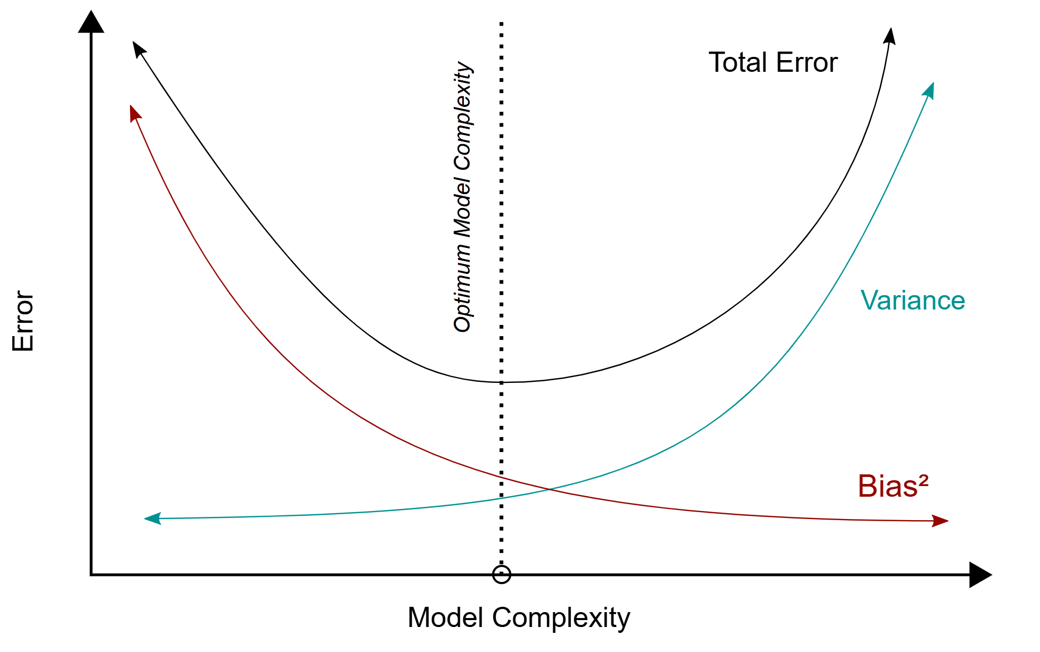
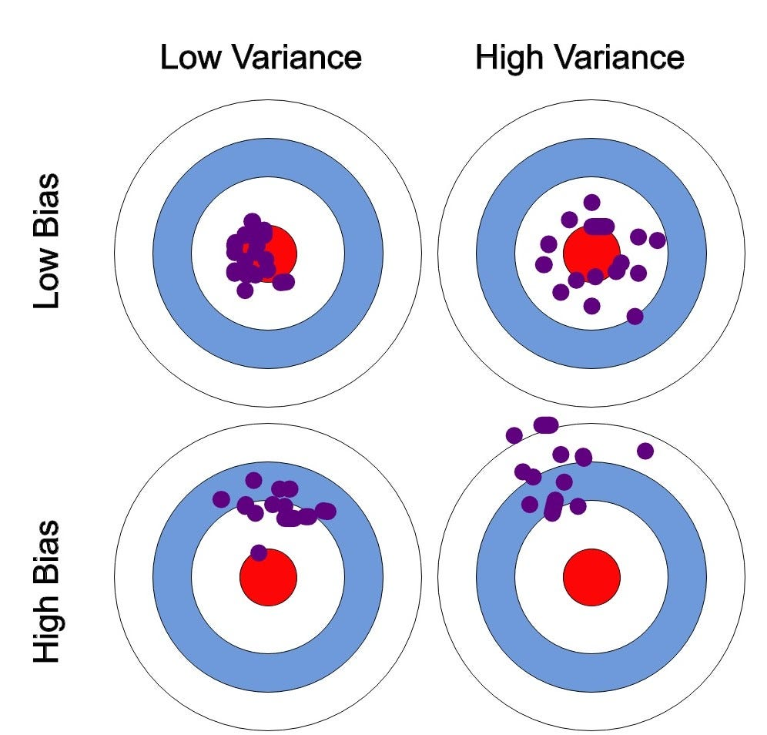
Bias-variance curves
Bias - systematic error caused by wrong assumptions in the model. High bias = model is too rigid
Variance - model changes too much depending on the training data. Model too flexible
Model complexity
Overfitting - when a model learns the training data too well—including noise and random fluctuations, so it performs poorly on new, unseen data.
Underfitting - when a model is too simple to capture the underlying pattern in the data, resulting in poor performance on both training and unseen data.
Degree of polynomial
Depth of trees etc.

Slide 15
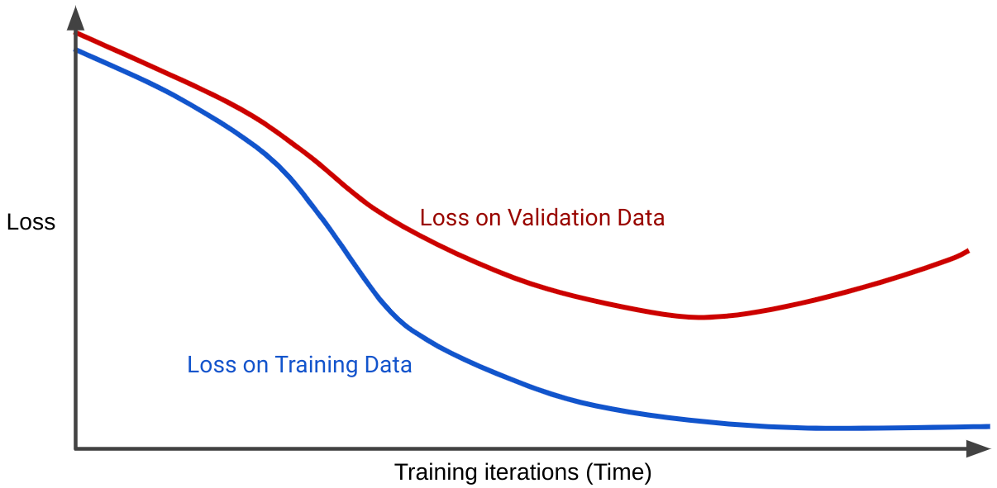
Diagnostics
https://github.com/DDursun/Overfit_ANNs_diagnosis

Slide 16
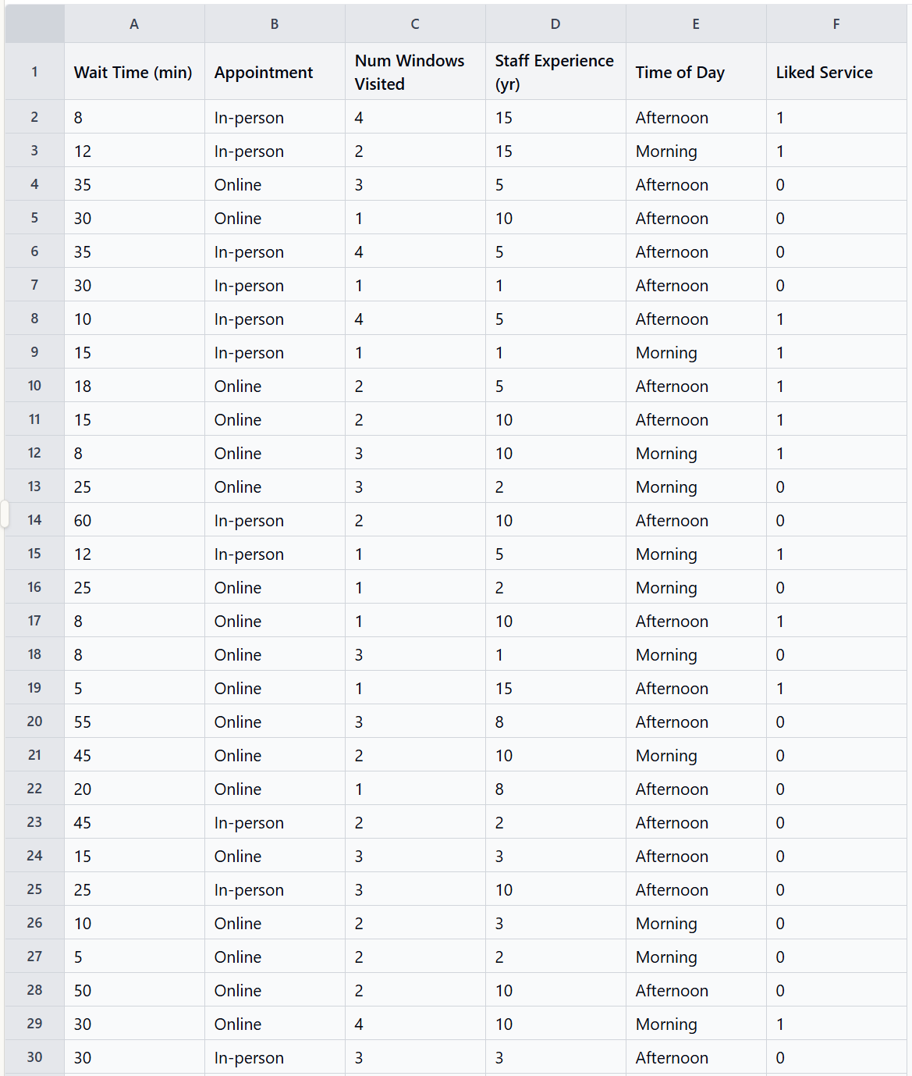
Validating models
Purpose of splitting data is model evaluation. Using your test set for improving your training performance is kind of cheating.
Train-test split
Train-Validate-Test
Train
Train
Validate
Test
Test

Slide 17
validation
is cool but …
The result can be highly dependent on that specific split.
With small datasets, the variance of the estimate can be large
It gives one performance estimate instead of a distribution
- Some samples may never be used for training or testing
Train (60-70%)
Validate (15-25%)
Test (15-25%)
Train-test-validation split

Slide 18
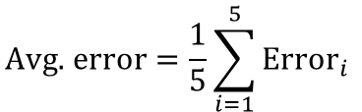
Cross validation
error₁
error₂
error₃
error₄
error₅
K-fold cross validation
$$\text{Avg}\text{. }\text{error}=\frac{1}{5}\sum_{i=1}^{5}{{\text{Error}}_{i}}$$
validate
validate
No/little dependency on split.
Distribution of performance
All samples used for train/val.
validate
validate
validate
You can also hold out small fraction for blind testing

Slide 19
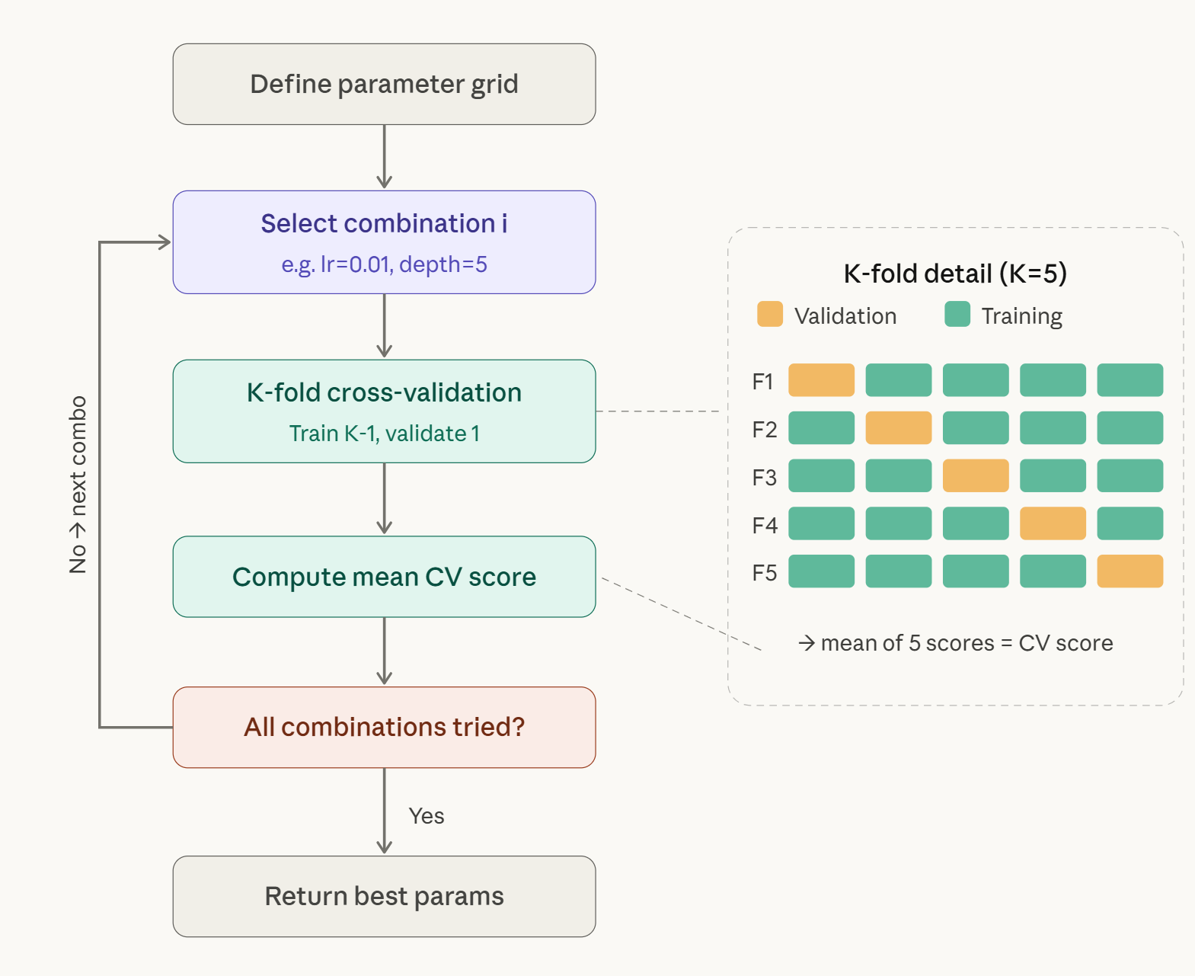
Hyperparameter optimization
Looking for best settings for your decision tree?
Grid search is exhaustive, scales exponentially with number of hyperparameters
Learning rate | Max_depth | N_estimators
0.001 | 5 | 50
0.01 | 10 | 100
0.1 | 15 | 200
Some tips:
Start with coarser grid then refine
Not all hyperparameters matter equally
Use Random Search when search space is not small

Slide 20
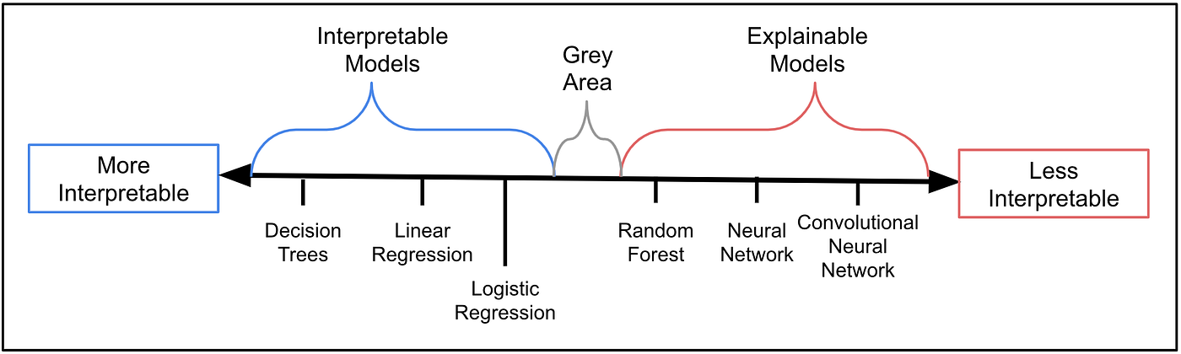
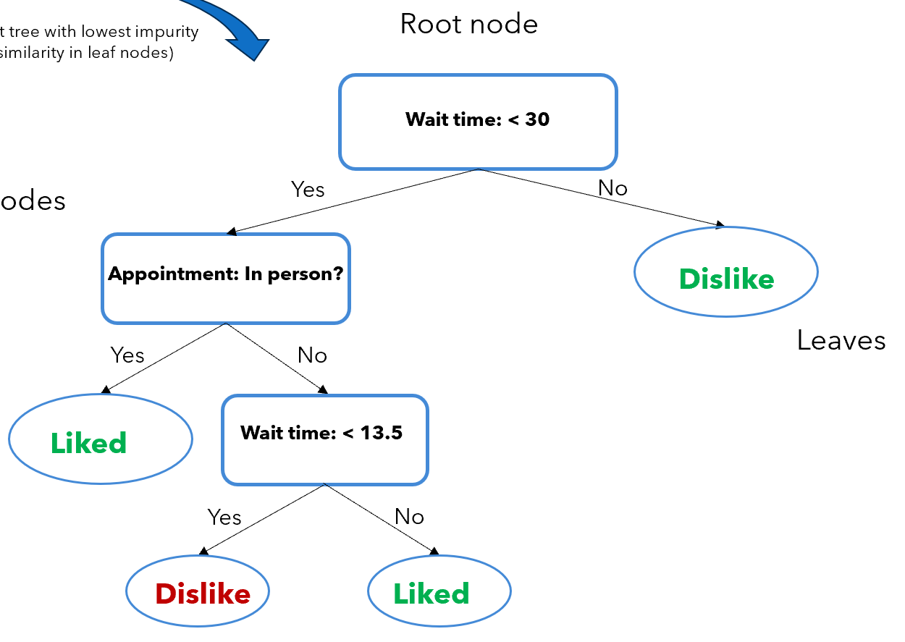

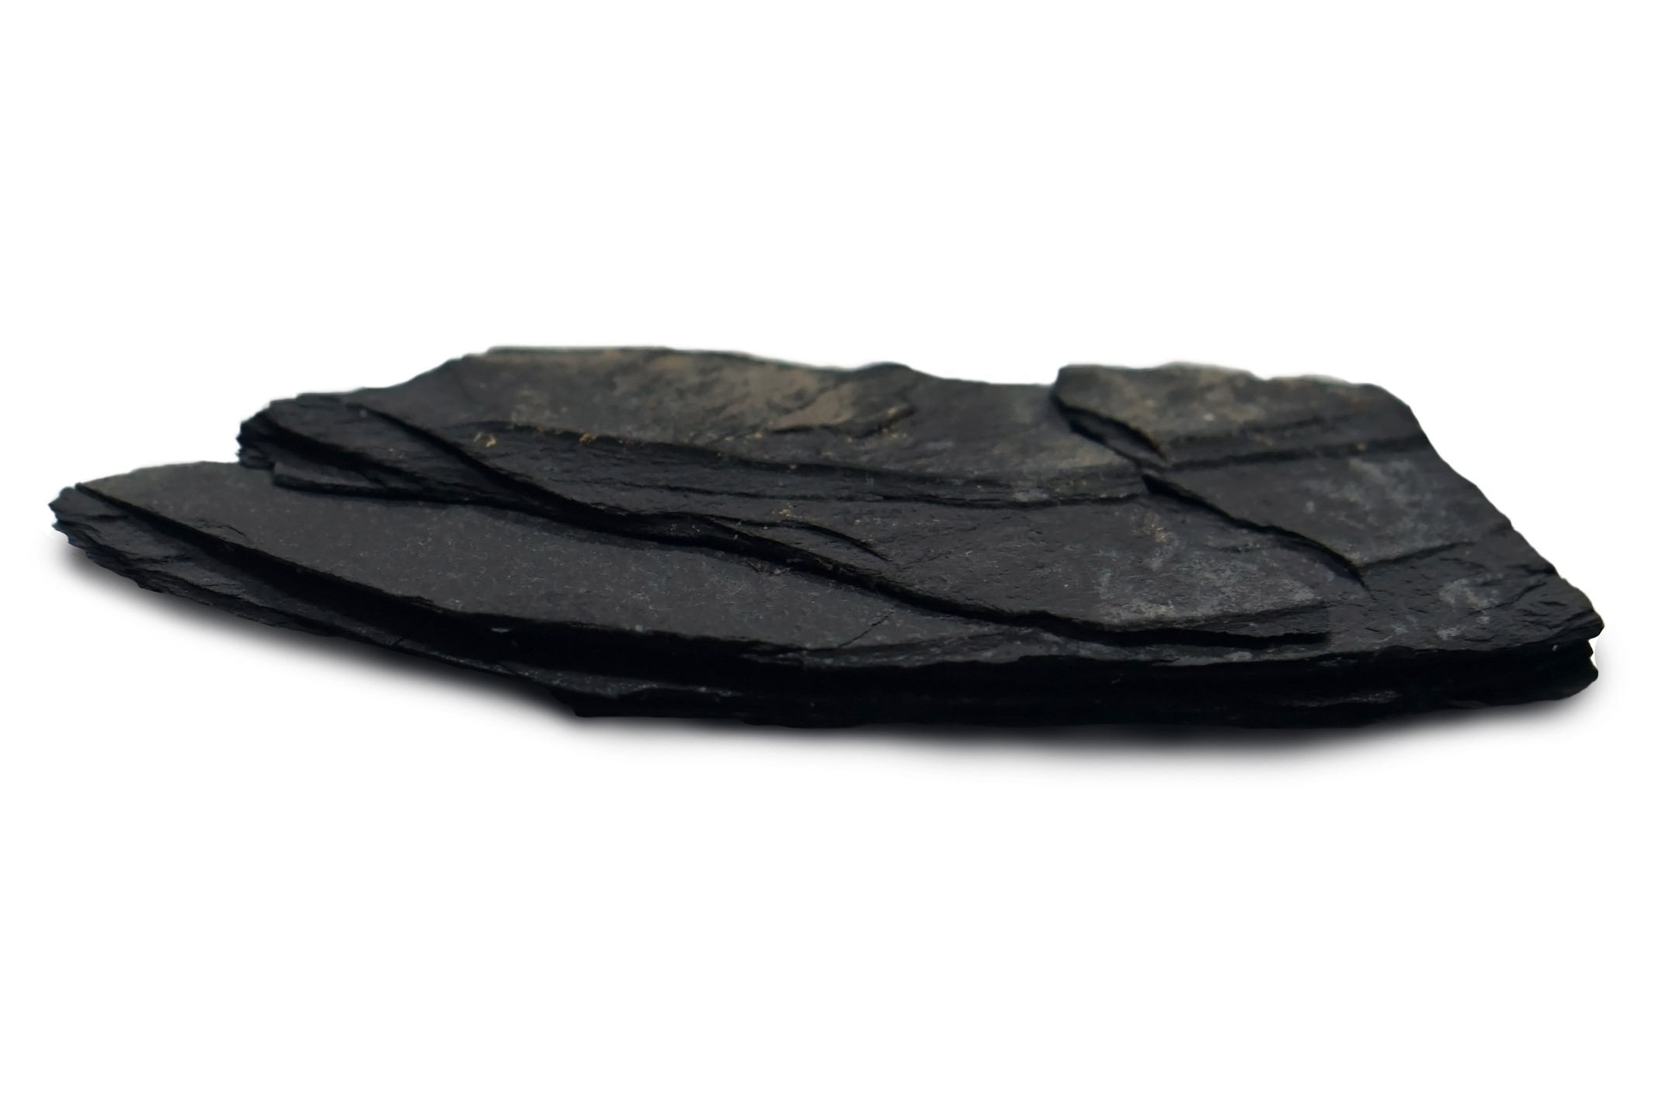




Interpretability
Interpretable model – a human can directly understand how the model makes predictions by inspecting its structure
Regression:
$$y = w_{1}x_{1}+w_{2}x_{2}+b$$
Decision trees
Explainability refers to usage of external methods to explain a model that is not inherently interpretable.
$$φ,k,britleness$$
ML Model
$$[18\%, 95 md, 0.7]$$
$$[7\%, 5 md, 0.3]$$
Image and some notes from: https://medium.com/data-science/interperable-vs-explainable-machine-learning-1fa525e12f48

Slide 21
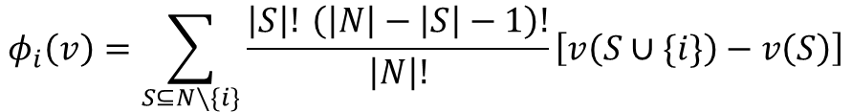


Shapely values
A method from game theory used to attribute a model’s prediction to individual features.
Weight term
$$φ_{i}\left(v\right)=\sum_{S⊆N∖\{i\}}{\frac{\left|S\right|! \left(\left|N\right|−\left|S\right|−1\right)!}{\left|N\right|!}}\left[v\left(S∪\{i\}\right)−v\left(S\right)\right]$$
prediction using features in $S and i$
prediction using only features in $S$
Weighting comes from counting permutations:
|N|! — total number of ways to order all N features
|S|! — number of ways to arrange the features that come before i
(|N|−|S|−1)! — number of ways to arrange the features that come after I
The numerator counts how many orderings place exactly the features in S before i → dividing by |N|! gives the probability of that specific arrangement
Lundberg, Scott M., and Su-In Lee. "A unified approach to interpreting model predictions." Advances in neural information processing systems 30 (2017).

Slide 22
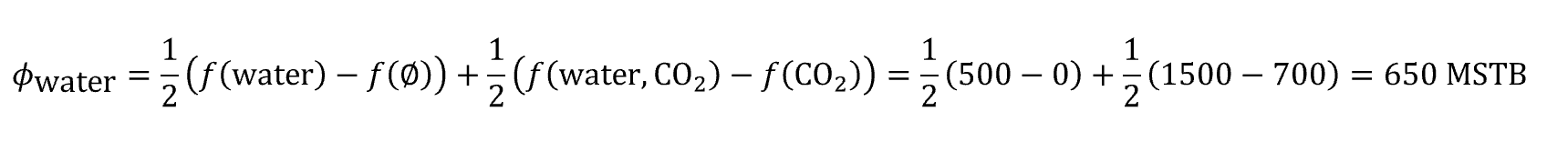
Marginal contributions
Example: A WAG (EOR) study is applied to reservoir together and team wants identify marginal contributions of each study. We have prior data for value of - water injection alone and CO₂ injection alone.
f(0)=0 f(water) = 500 MSTB f(CO₂) = 700 MSTB f(water, CO₂) = 1,500 MSTB
Contribution of water = avg of (contribution of water alone & marginal value when added after CO₂)
Contribution of CO₂ = avg of (contribution of CO₂ alone & marginal value when added after water)

Slide 23
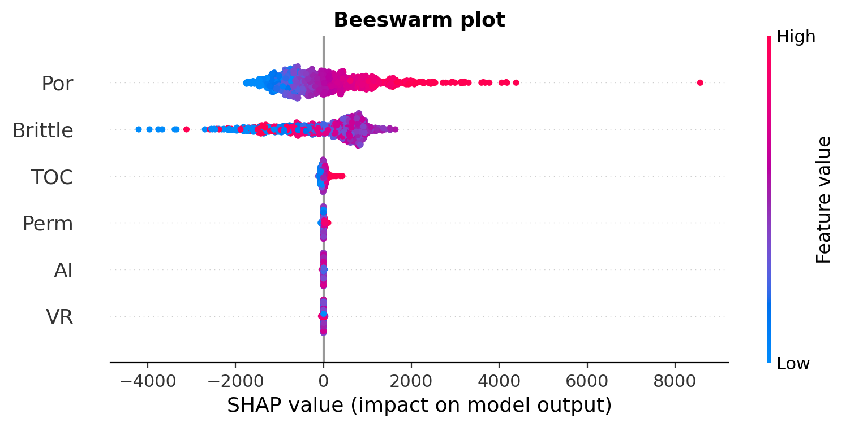
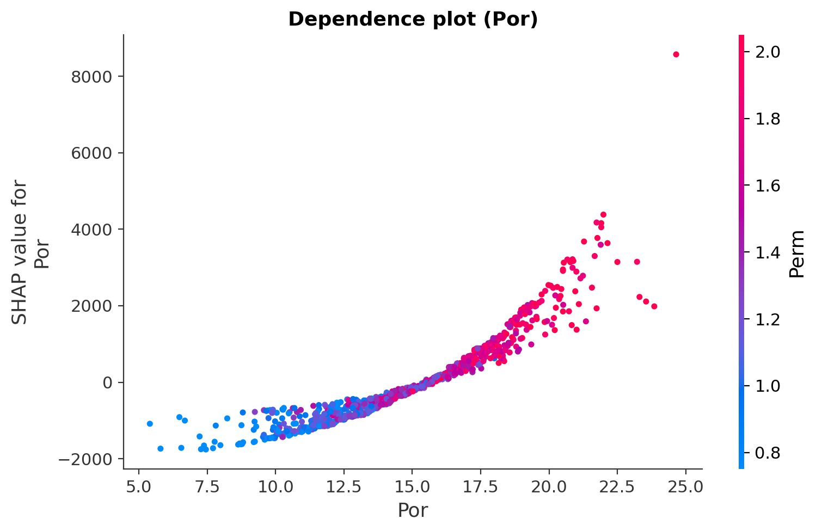
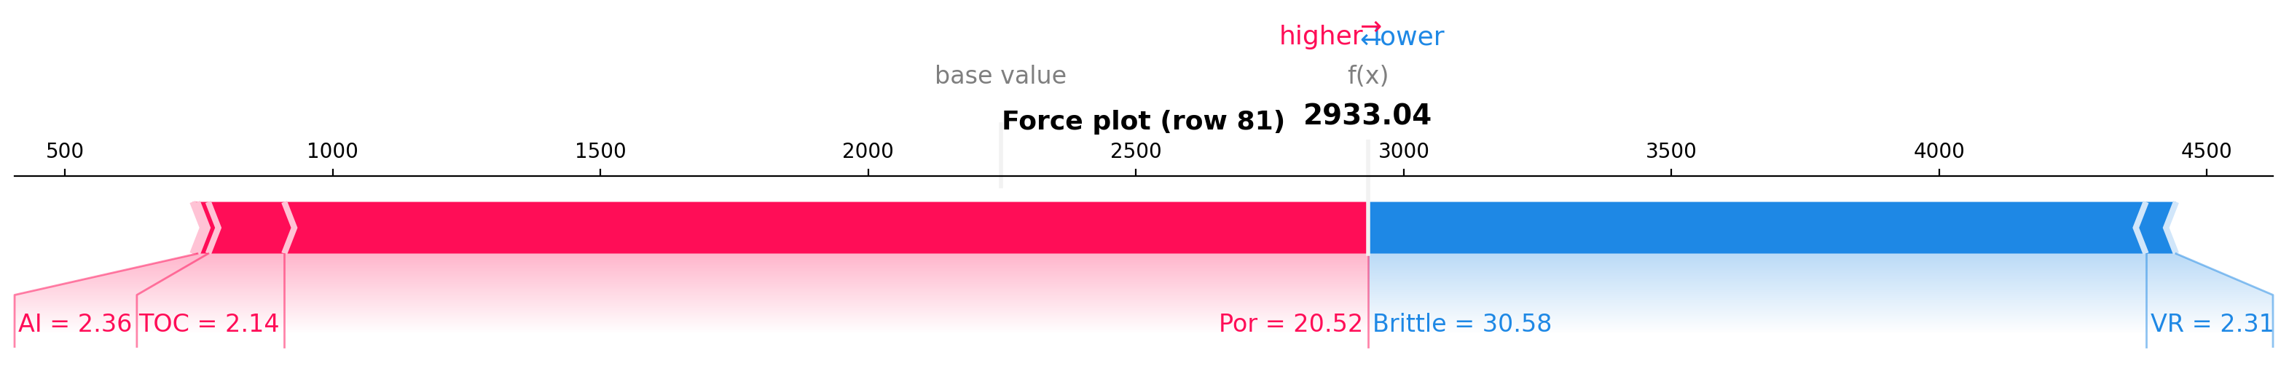
Shap visualizations
Notes:
Kernel PCA — applies the kernel trick to capture nonlinear relationships (maps to higher-dimensional space implicitly, then does PCA there)
T-sne and umap is nonlinear

Slide 24
Capstone project
Project will include 10-minute presentation with optional code example. You will receive a form for adding your project selection and confirming attendance.
This is not a case study; pick a topic you would like to explain and show:
How algorithm/approach works
Pros/Cons
Parameter selection (if applicable)
Grade distribution:
60% understanding and clarity of teaching
20% slides deck
20% code example
10% further reading resources (bonus)
Some ideas:
Handling imbalanced datasets
Partial Correlation Coefficient
Data leakages (how to avoid it)
Metrics (ROC curve and AUC etc.)
Support vector machines
Local Outlier Factor
Hierarchical clustering
T-SNE
Explainability - LIME
*Low-pressure meeting, no judgment for not knowing something—our goal is simply to learn together.

Slide 25
resources
Shapely:
https://www.youtube.com/watch?v=9haIOplEIGM
https://www.youtube.com/watch?v=oCIybnawLdg
Image references
https://mceri.engr.tamu.edu/images/general/streamline_depict.png

